Slide 1
Databases and Web Application Development UG2
Designing Databases: Databases as Data structures

Slide 2
Lecture

Slide 3
PLANNING A DATABASE DESIGN

Slide 4
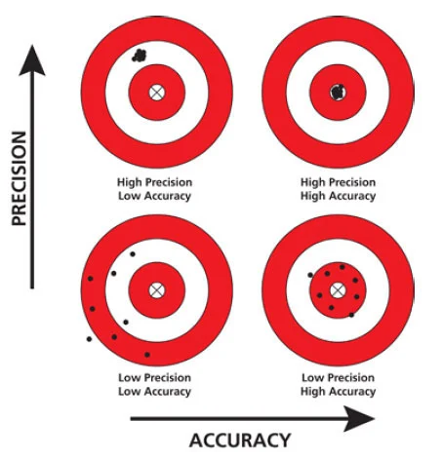
Accuracy
the degree of closeness to true desired value
Precision
the degree to which an process will repeatable result in the same value.

Slide 5

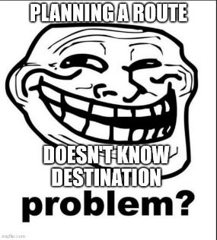
Planning and Designing
Like planning a route
What is the specific starting point?
What is the specific destination?
What are the constraints on how to get there?
In Science and Engineering we want to be as specific (accurate and precise) as possible
Formulating problems / questions
Formulating solutions / answers
Implement your Software before you have a Plan?
No clear starting point?
No clear destination?
No route!
Birmingham
?
London

Slide 6

Planning and Designing
Like planning a route
What is the specific starting point?
What is the specific destination?
What are the constraints on how to get there?
4 Cardigan St,
Birmingham
West Midlands
England
B4 7BD
?
United Kingdom?
Europe?
Earth?
London

Slide 7
Planning and Designing
BCU Cardigan Building
4 Cardigan St,
Birmingham
West Midlands
England
B4 7BD
Like planning a route
What is the specific starting point?
What is the specific destination?
What are the constraints on how to get there?
United Kingdom?
Europe?
Earth?
?
LSE Cowdray House
6 Portugal St,
London,
Greater London,
England
WC2A 2HJ
United Kingdom?
Europe?
Earth?

Slide 8
Planning and Designing
BCU Cardigan Building
4 Cardigan St,
Birmingham
West Midlands
England
B4 7BD
Like planning a route
What is the specific starting point?
What is the specific destination?
What are the constraints on how to get there?
By Air?
Helicopter?
Plane?
By River?
Boat?
Hovercraft?
By Road?
Car?
Walking?
By Train?
Heavy rail locomotive?
Light metro trail “The tube”?
Walking?
United Kingdom?
Europe?
Earth?
?
LSE Cowdray House
6 Portugal St,
London,
Greater London,
England
WC2A 2HJ
United Kingdom?
Europe?
Earth?

Slide 9
Planning and Designing
BCU Cardigan Building
4 Cardigan St,
Birmingham
West Midlands
England
B4 7BD
Like planning a route
What is the specific starting point?
What is the specific destination?
What are the constraints on how to get there?
By Road?
Exclusive
Car?
Walking?
Mixture?
Car?
Walking?
United Kingdom?
Europe?
Earth?
?
LSE Cowdray House
6 Portugal St,
London,
Greater London,
England
WC2A 2HJ
United Kingdom?
Europe?
Earth?

Slide 10
Planning and Designing
BCU Cardigan Building
4 Cardigan St,
Birmingham
West Midlands
England
B4 7BD
Like planning a route
What is the specific starting point?
What is the specific destination?
What are the constraints on how to get there?
By Road
Exclusive
Car
Anything else?
United Kingdom?
Europe?
Earth?
?
LSE Cowdray House
6 Portugal St,
London,
Greater London,
England
WC2A 2HJ
United Kingdom?
Europe?
Earth?

Slide 11
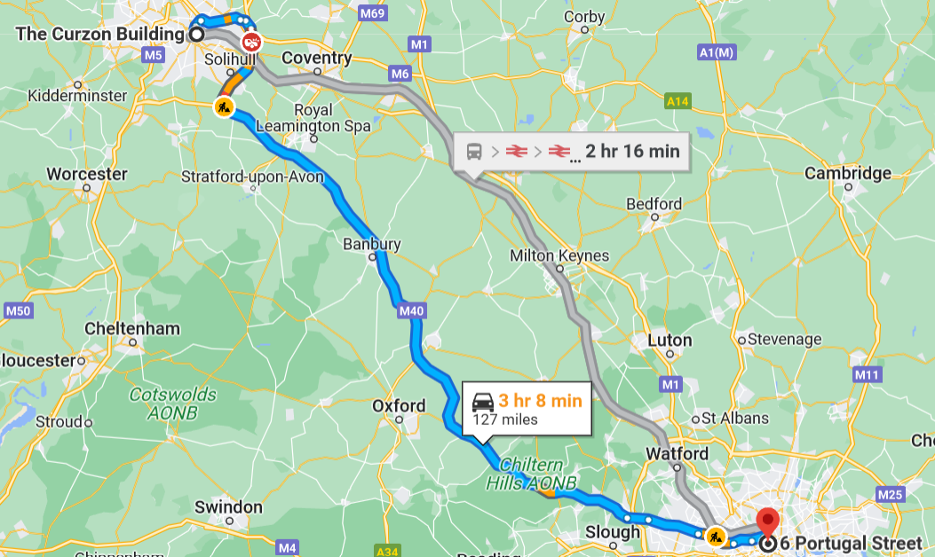
Planning and Designing
BCU Cardigan Building
4 Cardigan St,
Birmingham
West Midlands
England
B4 7BD
Like planning a route
What is the specific starting point?
What is the specific destination?
What are the constraints on how to get there?
United Kingdom?
Europe?
Earth?
Route
Plan
LSE Cowdray House
6 Portugal St,
London,
Greater London,
England
WC2A 2HJ
United Kingdom?
Europe?
Earth?

Slide 12
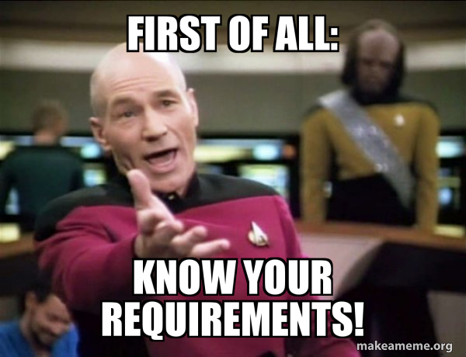
Requirements
What
Does it represent?
etc.
Why
Is it needed?
etc.
Who
Does it involve?
etc.
When
Should a process / transaction happen?
etc.
How
Should it be structured?
etc.

Slide 13
What you need to focus on?
Who is our Web Application for?
The User
What features will the web app have?
What would the user want / need from your system?
How will this work from the user’s perspective?
How will they use it?

Slide 14
What you need to focus on?
What data will need to be stored / accessed to support this feature set?
Based on the desired features
Think about specifics
Instead of generalities like “Customer details” or “Order details”
Think of specific items of data (attributes)
The name of a customer
The address of a customer
The email address of a customer
The product reviews a customer might have provided for items they have purchased
etc
What processing will we want to do on that data?
Based on the desired features
Starting point -> Destination
Inputs -> Outputs

Slide 15
CONCEPTS AND DEFINITIONS

Slide 16
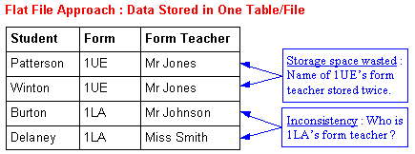
“Flatfile” Database Design
Data stored in a single big “table” or file
Issues
Redundant data
Storage space is wasted
Maintenance becomes more complex
Inconsistent data
Different values representing the same item being stored?

Slide 17
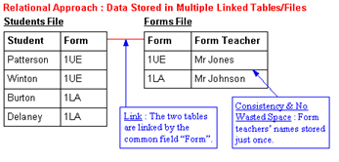
Relational Database Design
Allow data to be stored in separate groups.
Relations / Tables
Relations of attributes
“Groups” are connected to each other via relationships
Relations of records
By breaking the data into groups
Reduce the chance of mistakes happening
Does not take up any more space than necessary
Needs to be well designed
Notes:
Image courtesy of P Meakin 2004
https://ictsmart.tripod.com/ict4/online/artdbrf.htm

Slide 18
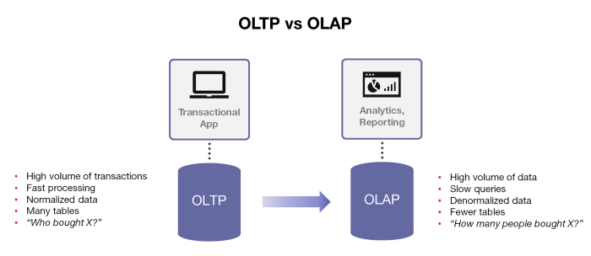
Online Transaction Processing
Up-to-date operational data
Used for day-to-day operations
Frequent read operations
Frequent write operations
Transactions / Queries
Should aim to deal with only a small amount of data at once
Many and small

Slide 19
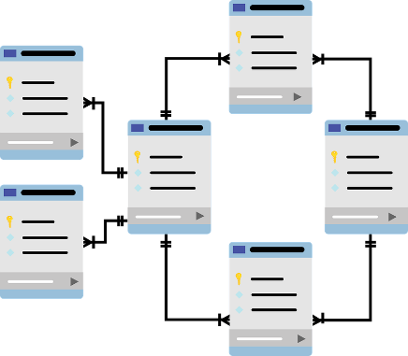
Database Schema
Describes the structure of a database in a formal language that is supported by the database management system.
Create a blueprint of the database.
This blueprint will not contain any data.
The database schema uses logical formulas to create integrity constraints.
It is not possible to insert data into the database that violates these integrity constraints.
All constraints use the same language.
Notes:
“Duke” image courtesy of Oracle Corporation
Example schema logo courtesy of:
https://pixabay.com/users/mcmurryjulie-2375405/

Slide 20
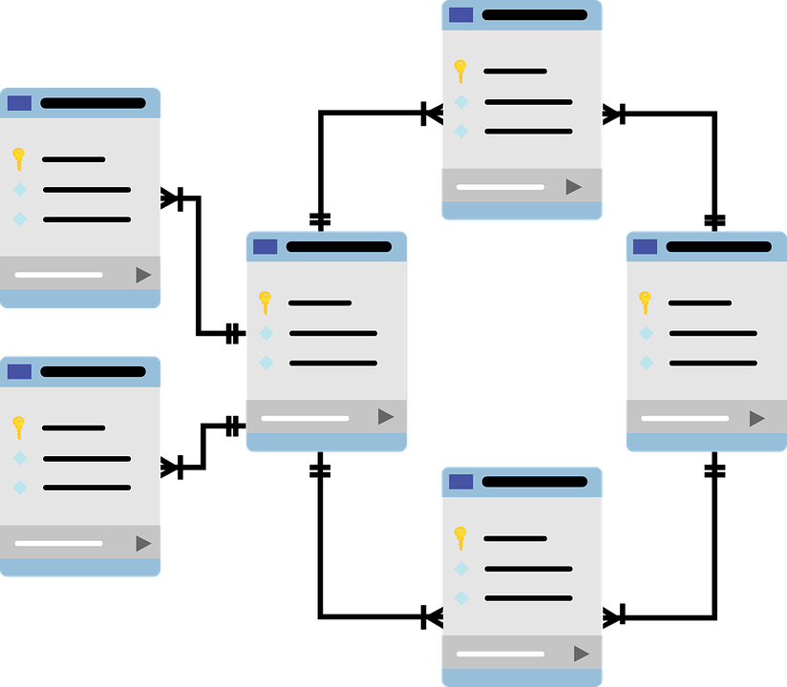
Database Schema
There are different kinds of database schemas:
Conceptual schema expresses the concepts in the database, and how they relate to each other
Logical schema is a mapping of entities with their attributes, and the respective relations
Physical schema is a particular implementation of a logical schema.
Notes:
Example schema logo courtesy of:
https://pixabay.com/users/mcmurryjulie-2375405/

Slide 21
Database Schema
Ideally, a database schema should have the following properties:
It should be complete: all information in the source should be included.
It should be minimal: it should not be possible to leave out a relation, without losing information
It should be normalised: A certain piece of data should be in the schema only once.
Notes:
Example schema logo courtesy of:
https://pixabay.com/users/mcmurryjulie-2375405/

Slide 22
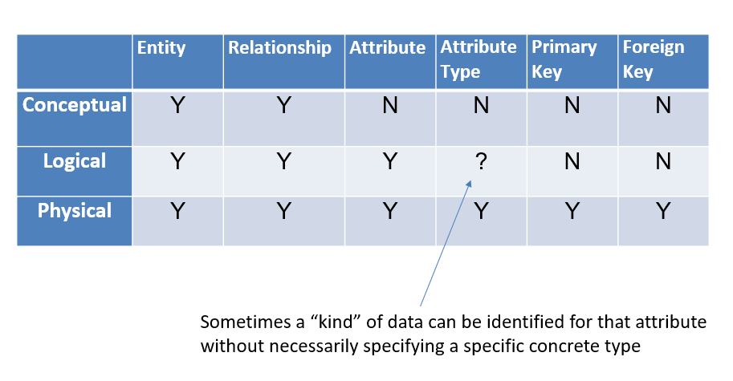
Database Design
Before we create a database, we need to design one
Conceptual Design
Build a model of the database independent of DBMS details
Logical Design
Model further structure of the data
Still abstract enough to be independent of DBMS details
Physical Design
How is the data within the database precisely stored and managed by the DBMS?
Specific types
Keys
Indexes
etc

Slide 23
ERD Type
 | Entity | Relationship | Attribute | Attribute Type | Primary Key | Foreign Key
Conceptual | Y | Y | N | N | N | N
Logical | Y | Y | Y | ? | N | N
Physical | Y | Y | Y | Y | Y | Y
Sometimes a “kind” of data can be identified for that attribute
without necessarily specifying a specific concrete type

Slide 24
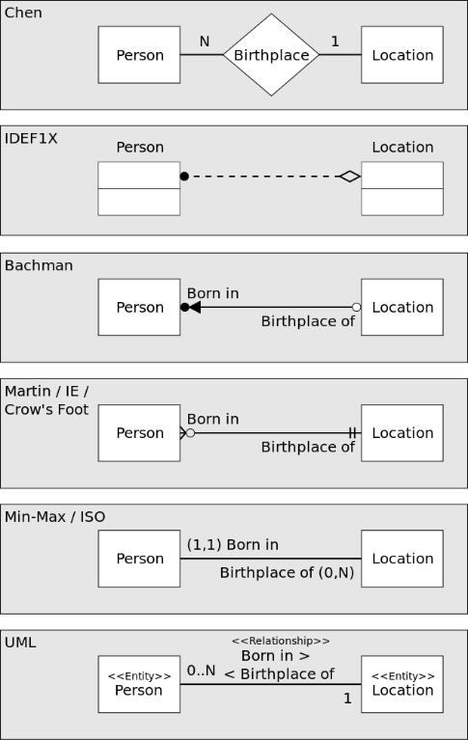
Entity Relationship Diagrams
A type of structural diagram for use in database design.
Entity Relationship Modelling is an approach to semantic modelling of data within information systems
The process of entity relationship modelling was originally defined by the work on Chen (1976) and has been continued to be refined through further work since.
Different notations / styles
Representing the same information
Recommended: “Crow’s Foot”

Slide 25
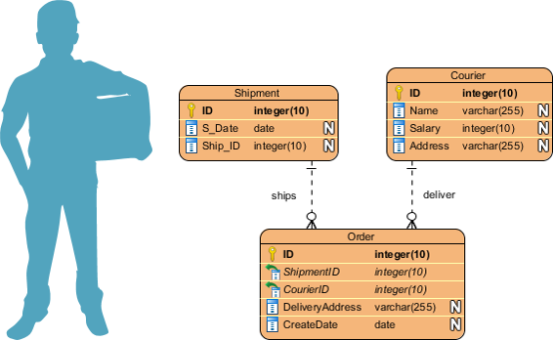
An Example ERD
Entities
Shipment
Courier
Order
Attributes
S_Date is a date and belongs to Shipment entity
Name is a variable length character array and belongs to the Courier entity
etc
Relationships
An Order is shipped via a single Shipment
A Shipment can ship many Orders
An Order is delivered by a single Courier
A Courier can deliver many orders
Records
Each individual Shipment, Order or Courier would be represented as a “row” in our final table
Think of the Records as the “Objects” to the Entity / Tables “Classes”

Slide 26
Entity/Relationship Modelling
E/R Modelling is used for designing our data model
Identify Entities
objects or items of interest
Identify the Attributes
facts about, or properties of, an entity
Identify the Relationships
links between entities
Establish cardinality of relationships
How many records of one entity can be related to how many records of another entity?
Establish modality of relationship
Is the relationship optional, or mandatory?
Identify keys
Primary key
What value can be used to uniquely identify each record in the entity?
StudentID?
StudentEmailAddress?
Example
For a university database:
Entities – Students, Modules, Lecturers
Students attributes could be – Student ID, Name and course
Could have relationships with Modules (enrolment) and Lecturers (tutor/tutee)
Cardinality
E.g. A student may study multiple modules while a module may be studied by many students
Modality
e.g.

Slide 27
Lab Talk

Slide 28
Entity Relationship Modelling

Slide 29
Entity Relationship Diagrams
A type of structural diagram for use in database design.
Entity Relationship Modelling is an approach to semantic modelling of data within information systems
The process of entity relationship modelling was originally defined by the work on Chen (1976) and has been continued to be refined through further work since.

Slide 30

Entity

Slide 31

Relationship

Slide 32
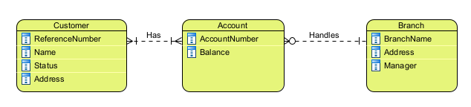
Attributes

Slide 33
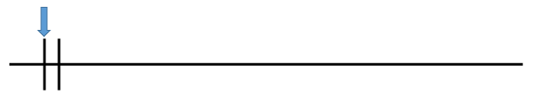
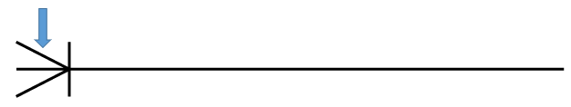
Cardinality and Modality
Cardinality: Multiplicity
Maximum amount of times an instance of one entity can be associated with instances of another entity.
One
Many

Slide 34
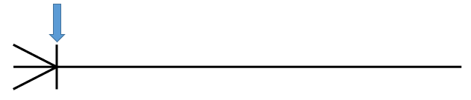
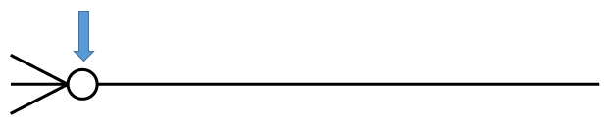
Cardinality and Modality
Modality: Minimality
minimum number of times one instance can be related to others.
One
Zero

Slide 35
Cardinality and Modality
One
One or more
Zero or more

Slide 36

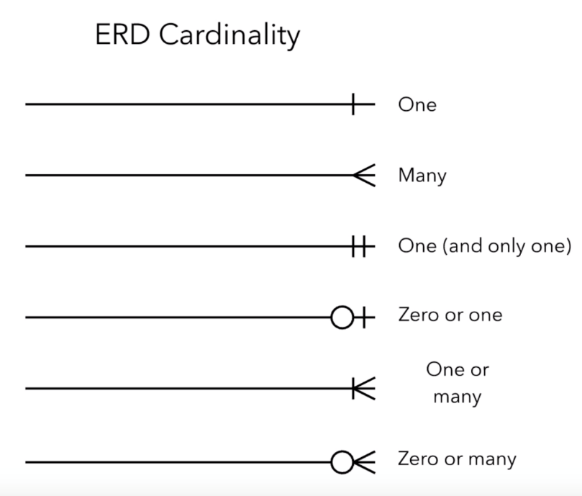


Cardinality and Modality

Slide 37

Keys
Candidate key
A collection of one or more attributes which can be used to uniquely identify records belonging to a given table / entity
Primary Key
Chosen from the candidate keys
A unique identifier for a record within a table / entity, ensuring that no two records have the same identifier.
Unique constraint
Not null constraint
Foreign Key
A reference to the primary key of another table / entity

Slide 38
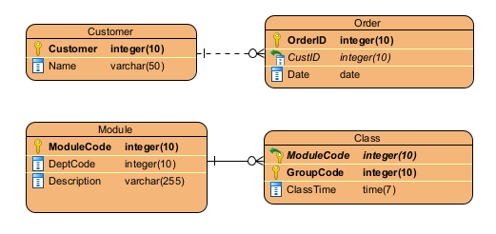
Identifying Relationship
Weak
Non-identifying
Existence is independent
Usually PK of Child doesn’t contain PK component of Parent Entity
Strong
Identifying
Existence is dependent on another entity
Usually PK of Child contains PK component from a Parent Entity
“If we delete a record for one entity
what happens to the records linked to it
for another entity?”

Slide 39
ERD Type
 | Entity | Relationship | Attribute | Attribute Type | Primary Key | Foreign Key
Conceptual | Y | Y | N | N | N | N
Logical | Y | Y | Y | ? | N | N
Physical | Y | Y | Y | Y | Y | Y
Sometimes a “kind” of data can be identified for that attribute
without necessarily specifying a specific concrete type

Slide 40
ERD Type
 | Entity | Relationship | Attribute | Attribute Type | Primary Key | Foreign Key
Conceptual | Y | Y | N | N | N | N
Logical | Y | Y | Y | ? | N | N
Physical | Y | Y | Y | Y | Y | Y
?
Note: some diagramming tools use colour to differentiate, instead get into the habit of looking at what constraints are met with the diagram

Slide 41
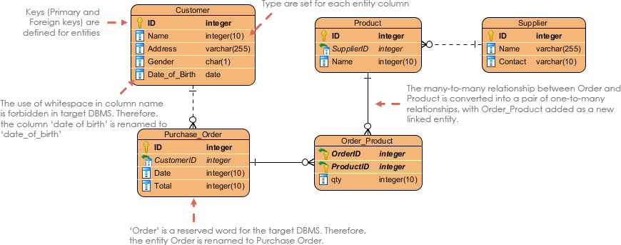
Example
Conceptual, logical, or physical model of the database? Why do you think so?
Think of at least 3 sample record tuples to represent “rows” for each relation/table.
What limitations does this specific database structure have?
What possible use cases may not be possible based on these limitations?
What additional constraints could be placed on the attributes within each table to prevent invalid data being stored?

Slide 42
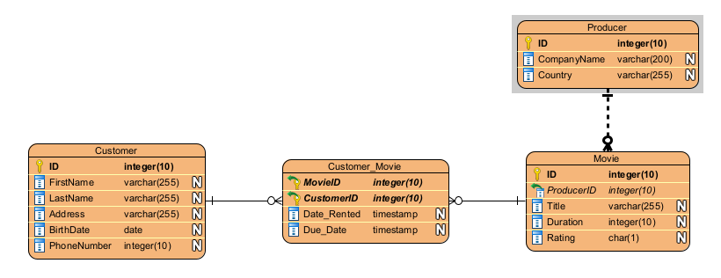
Example

Slide 43
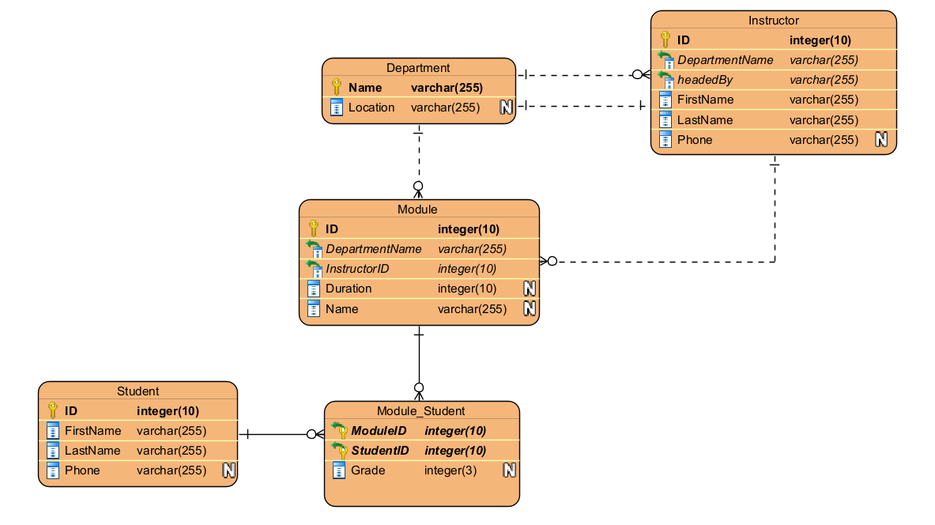
Example

Slide 44
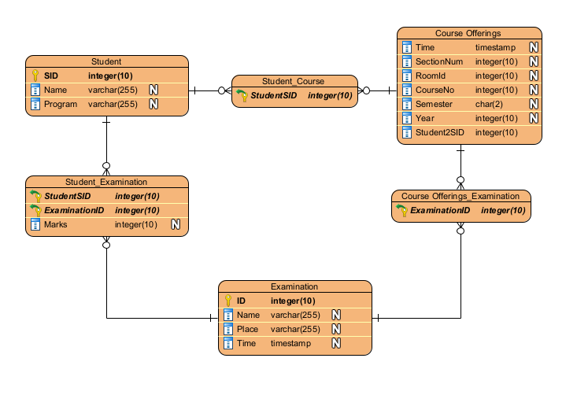
Example

Slide 45
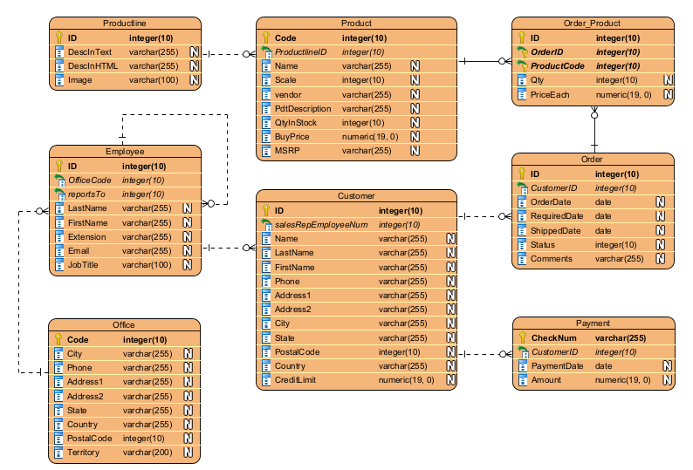
Example

Slide 46
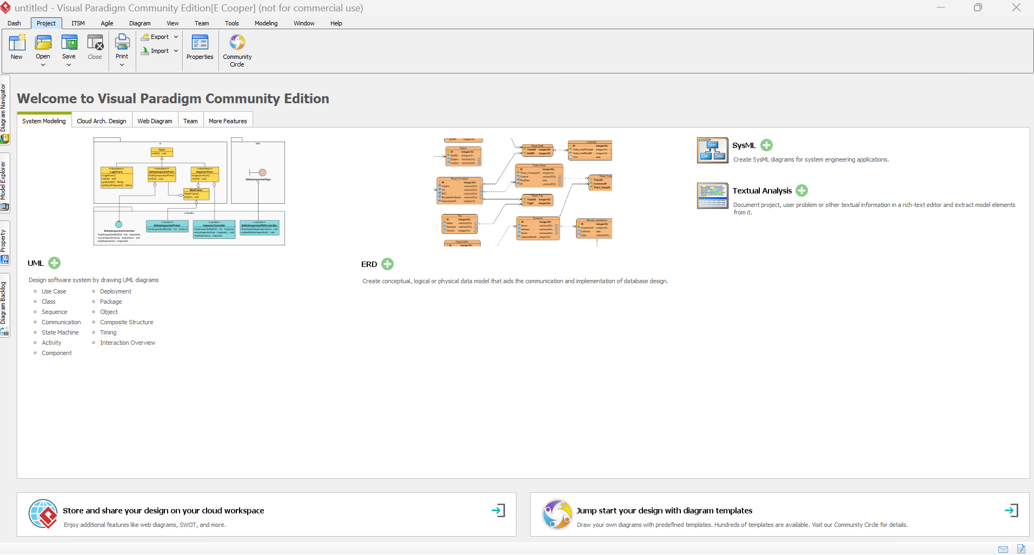
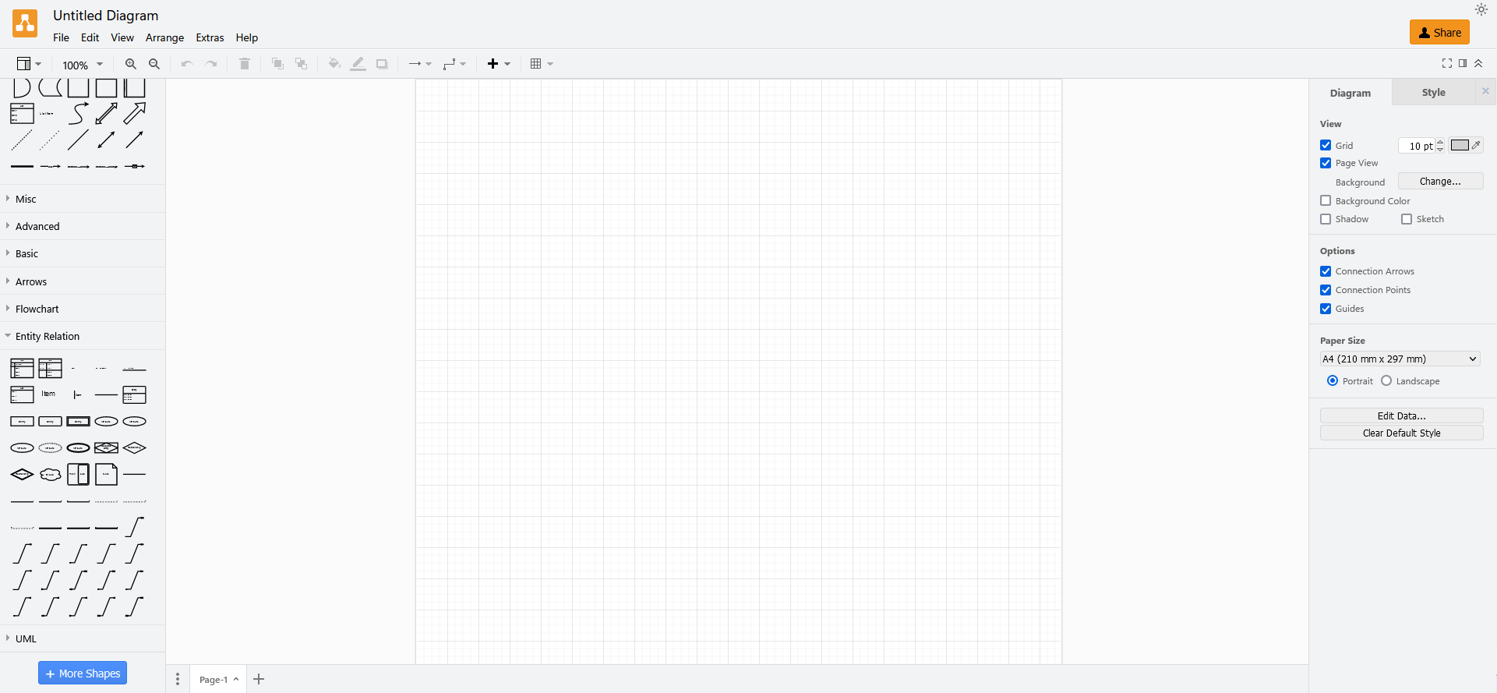
Diagramming Software
Draw.io (free)
Visual Paradigm Community (free but limitations)
Recommend draw.io as least likely to cause issues with locking off features.
However, Visual Paradigm (full version) is a very useful feature rich application for Software Design in general, see it as a possible alternative.

